Slide 1
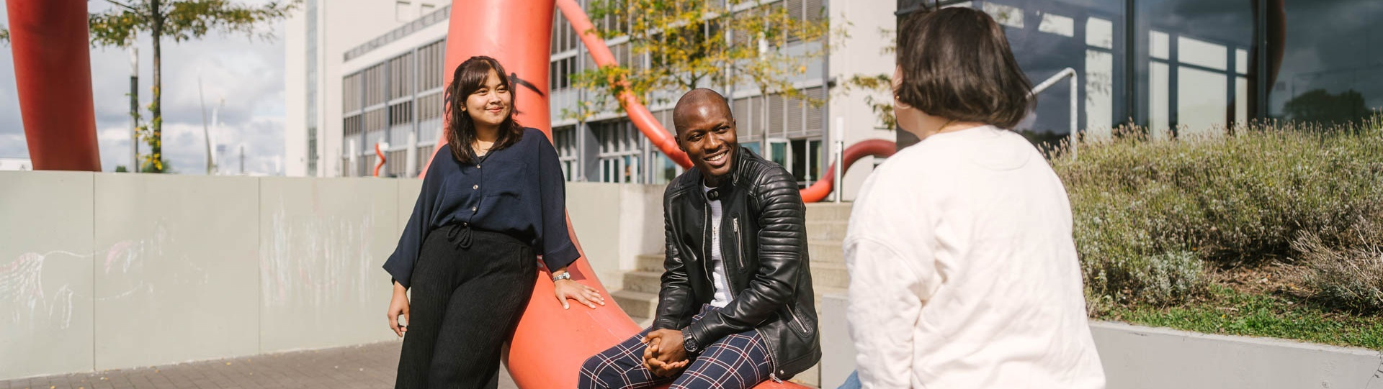
Requirements Engineering
HTW Berlin
Thomas Berger/ April 2023

Slide 2
Recap
Thomas Berger
Why do we need a requirements and requirement engineering
Requirement types

Slide 3
Requirement
The “top seven” of requirements anti-patterns
“Shooting on running targets”: it changes implicitly over time;
“Two at the price of one”: two or more requirements hide in one.
“Out of scope”: you specify behavior of other things.
“Negative”: you specify what the system should not do.
“Too specific”: the requirement is “almost source code”, anticipates system design or the like.
“Too unspecific”: you don’t exactly write down what you mean.
Sub-taste “lazy specifier”: while specifying you think “Come on, y’ know whatta mean”.

Slide 4
Requirement
What are good requirements?
Specify only what is necessary and within product scope!
Be as specific as necessary and as unspecific as possible! (Don’t take developer’s work away by breaking down everything into bits and bytes.)
Write positive requirements only! (There is much less to do for you as the system does much less than it does not.)
Don’t be lazy! (The other side doesn’t always know what you mean and sometimes they don’t even want it.)
Use a clear language and phrase short sentences! (Longer sentences are a sure sign for too much detail.)

Slide 5
2. From Ideas to Product Requirements

Slide 6
Agenda – From Ideas to Requirements
1
From Ideas to Requirements - A User Centered Approach
2
Usability & User Experienced Design
3
Use Journey Mapping
4
Use Scenarios
5
Prototyping
6
Usability Evaluation

Slide 7

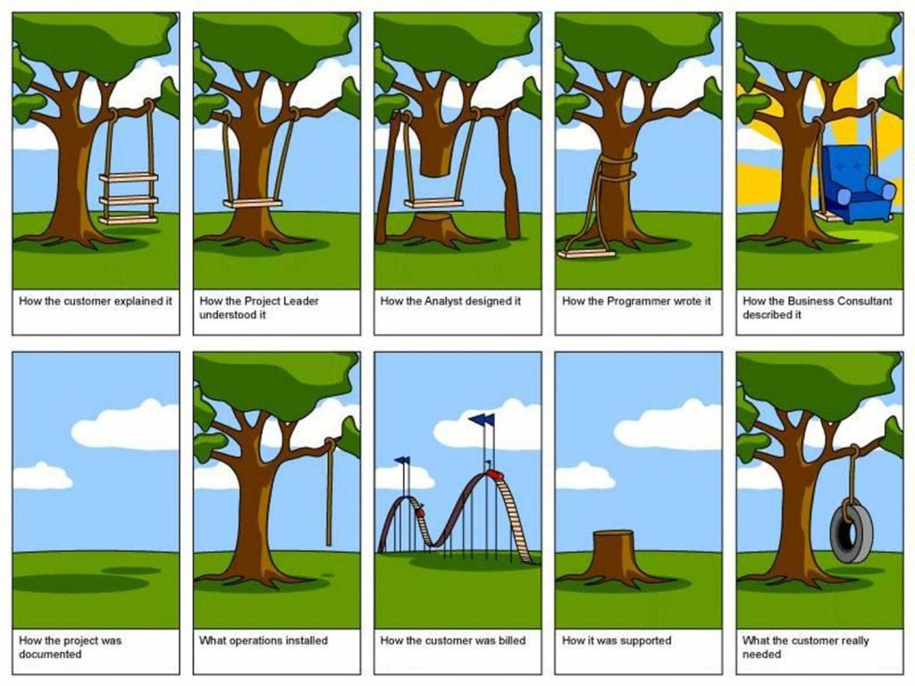







Product Requirement Document is the main source document for the product description in a project
Idea
customer perspective
Stakeholder, customer agree on…
PRD
Description Technical solution
TSD
Product team designs...
Product
Product team develops...

Slide 8
Product Requirement Document
PRD
Contains…
Title & author information
Revision information
Purpose and scope, from both a technical and business perspective (Service, System, which part of the system,…)
User/ Actors
Market assessment and target demographics (chances, new in the market, countries)
Product overview (Use scenarios, use cases, …)
Compatibilities to other products
Requirements, including
functional requirements (e.g. what a product should do)
usability requirements
technical boundaries (e.g. security, network, platform, integration, client)
environmental requirements
…
…

Slide 9












Ask & Listen to the User - Prototyping
Ideation
Initial version
Update
PRD
Marketing talks
Gather Existing Info (Competition Analysis, …)
corresponds
Hey folks, let‘s talk how to sell..
Input for talks
prototype
Input for talks
Hey user, let‘s talk about the future
Product owner
Marketing Guru
Input
Update
Usability evaluation and design iteration
Prepare first wishes, ideas and key features
Stakeholder
User
Prototype version i++
Technical feasibility
UX Design
Design concept
Hey Designer, let‘s talk about a new product
Hey Dev Guru, let‘s talk about if this is feasible
Input
Input
Product owner
UX Designer
Product owner
Dev Guru

Slide 10
Involve users…
https://www.reddit.com/r/gifs/comments/9ogmes/kids_would_rather_not_use_the_slides_but_instead/?utm_source=share&utm_medium=web3x&utm_name=web3xcss&utm_term=1&utm_content=share_button

Slide 11
Training – Ideation: Webshop Hotel Booking
Ideation
Initial version
Update
Use a mindmap to gather and document ideas…
Mindmap tools
Mural (https://start.mural.co/)
Xmind (https://www.edrawsoft.com/de/ad/xmind.html)
PRD
Marketing talks
Gather Existing Info (Competition Analysis, Live Cases, techncial data…)
corresponds
Hey folks, let‘s talk how to sell..
Input for talks
prototype
Input for talks
Hey user, let‘s talk about the future
Product owner
Marketing Guru
Input
Update
Usability evaluation and design iteration
Prepare first wishes, ideas and key features
Stakeholder
User
Prototype version i++
Technical feasibility
UX Design
Design concept
Hey Designer, let‘s talk about a new product
Hey Dev Guru, let‘s talk about if this is feasible
Input
Input
Product owner
UX Designer
Product owner
Dev Guru

Slide 12
Agenda – From Ideas to Requirements
1
From Ideas to Requirements - A User Centered Approach
2
Usability & User Experienced Design
3
User Journey
4
Use Scenarios
5
Prototyping
6
Usability Evaluation

Slide 13
What is Usability
Usability means, you can use it with it‘s intended use

Slide 14
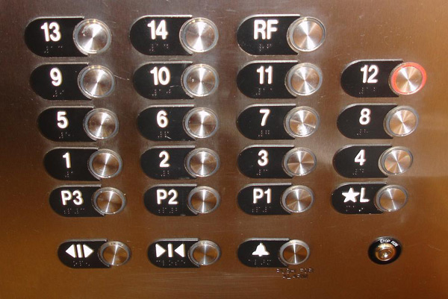
What is Usability
Usability means, you are not confused!

Slide 15
What is Usability
Usability means, you can use it safely

Slide 16
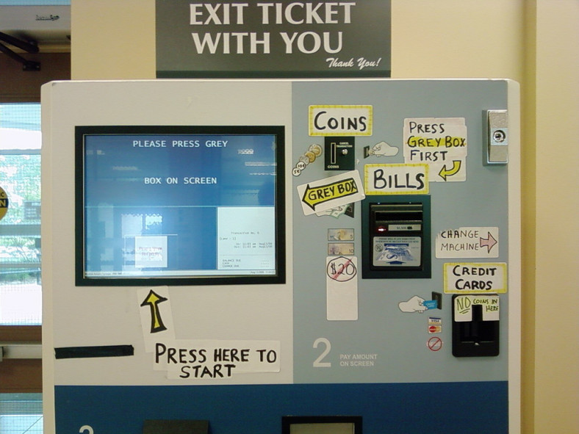
What is Usability
Usability means, you can use it without further explanations

Slide 17
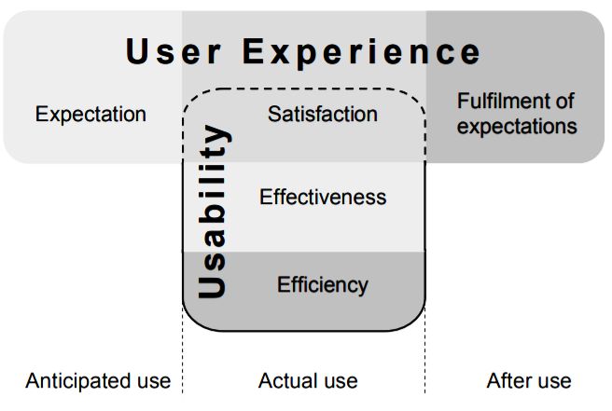
User Experienced (UX) Design & Usability
UX can be seen as a holistic approach to satisfy the customer from the first contact with the product to removal of the product.
Usability is what we measure during product usage
Usability = „The extend to which a product can be used by specific users to achieve specified goals with effectiveness, efficiency and satisfaction in a specified context of use.“ (ISO 9241-11)

Slide 18
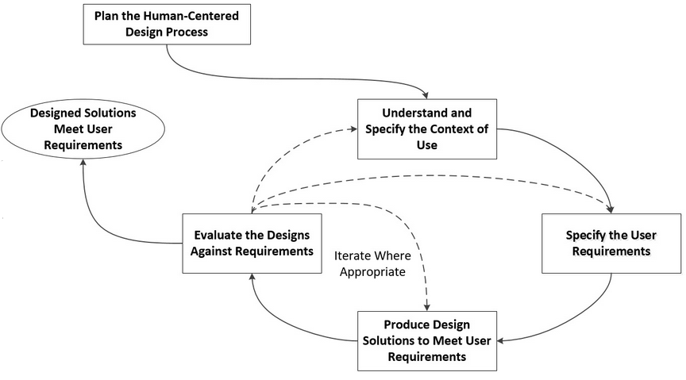
Usability Engineering Lifecycle (UEL)

Slide 19
Usability is Part of Requirements Engineering
Usability-Engineering Lifecycle first described by Mayhew D. (1999) can be matched with User-Centered Design illustrated in ISO 9241-210
I Requirements Analysis (User Research)
III Installation
II Design / Testing / Development

Slide 20
Agenda - From Ideas to Requirements
1
From Ideas to Requirements - A User Centered Approach
2
Usability & User Experienced Design
3
User Journey
4
Use Scenarios
5
Prototyping
6
Usability Evaluation

Slide 21
User / Customer Journey
A Better Understanding of Customer’s Emotions
When you build a customer’s journey , you can understand the reasons behind the customer’s every action. It helps improve the organization’s function and identifies the friction points in a customer’s journey.
Analyzing Customer Pain Points Across Your Products or Services
You can understand problems by creating maps and understanding the customer’s journey. Also, use this information to define a roadmap.
Improve Employee and Customer Satisfaction
By resolving the issues, you can boost customer and employee satisfaction. Often, dissatisfaction drivers are captured in the journey mapping exercise. Identifying clear focus areas will also provide motivation and direction to employees.
Create a United Team
All your company's teams need to be on the same page, which is possible by understanding the customer journey. When the team works together to map the journey, team members understand cross-department relationships and how everyone contributes to making the customer experience work.

Slide 22
User / Customer Journey
A customer journey map refers to the visual storyline of a customer’s engagement with a product, brand, or service. By creating the map, a company can think like its customers.
A proper customer journey map shows all customer interaction touchpoints with the brand. It includes how the customers first heard about the brand to their direct interaction with the brand or product. In short, the customer journey map shows customers' actions over time.

Slide 23
User / Customer Journey
When looking across customer segments, journey mapping:
It lets the companies optimize the customer onboarding process.
It helps you understand the difference in buyers’ behavior when they move from prospect to conversion.
You can benchmark your customer’s desired experience against what they receive.
It helps you create logical order for the buyer's journey.

Slide 24
Creating User / Customer Journey
Create personas
Prioritize personas
List customer touchpoints
Identify customer Actions

Slide 25
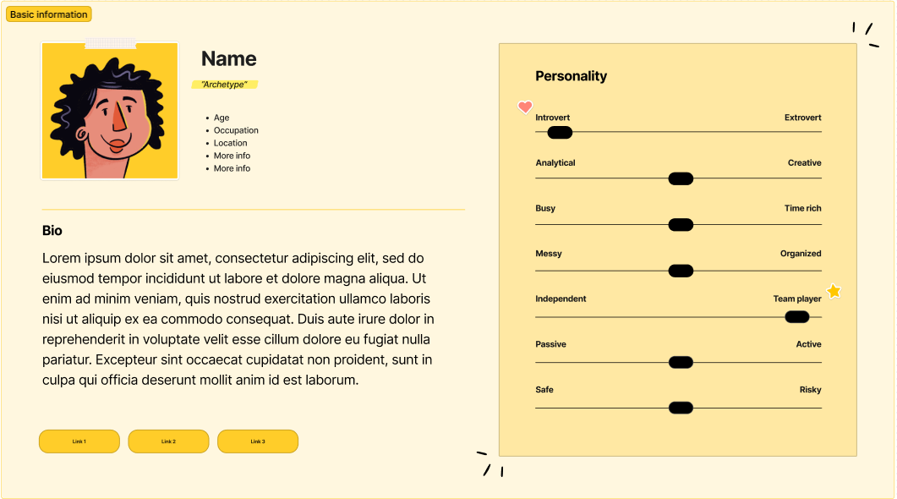
Creating User / Customer Journey - Persona
…is a fictional character created to represent a user type that might use a site, brand, or product in a similar way.
Tool to create personas
https://www.figma.com/

Slide 26
Training – Personas: Webshop Hotel Booking
Creating and prioritize personas
Tool: Figma

Slide 27
Creating User / Customer Journey
Identify different stages:
Awareness: The customer gets aware of the product (why should the customer use the product)
Consideration: The customer compares the product and considers to use it (why should the customer trust us)
Acquisition: The customer decided for the product and uses it for the first time (how can they feel successful during onboarding)
Service: The customer uses the product continously (how is using over one year)
Loyalty: The customer recommends the product to other customers (sharing – why would they invite others)

Slide 28
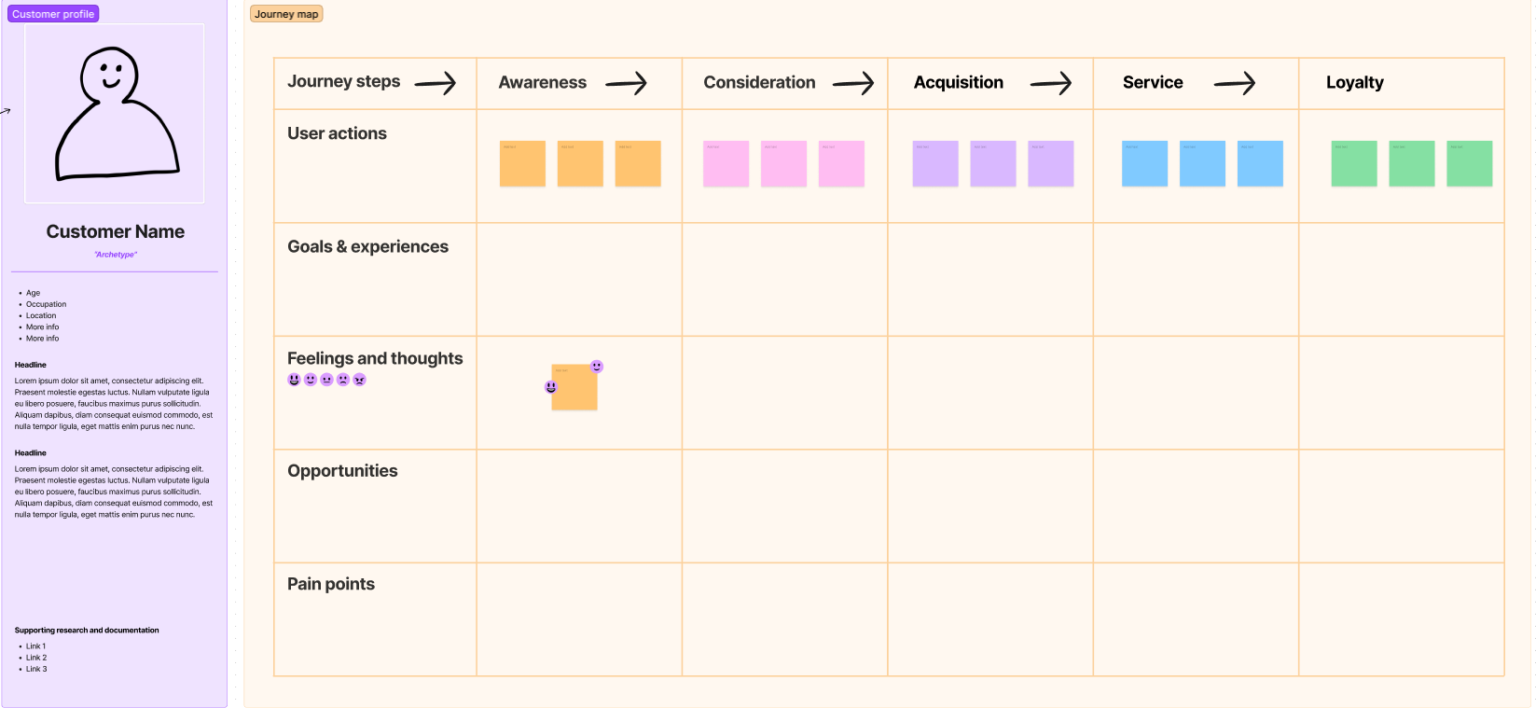
Creating User / Customer Journey
For each persona and for each stage document:
User actions
Goals /Needs
Feelings
Opportunities
Pain points
Touch points

Slide 29
Training – User Journey: Webshop Hotel Booking
Creating a user journey for one persona
Tool: Figma

Slide 30
Creating User / Customer Journey
Important – Check your assumptions with users (interviews)!
A very good tool for high-level communication with stake holders
User journey map is a very good tool to communicate high-level with other stakeholders
Good tool for communication with management board
Can be part of the product requirements as part of the introduction and justification for tge product

Slide 31
Agenda - From Ideas to Requirements
1
From Ideas to Requirements - A User Centered Approach
2
Usability & User Experienced Design
3
User Journey
4
Use Scenarios
5
Prototyping
6
Usability Evaluation

Slide 32
Understand and Specify the Context of Use → Create Use Scenarios
Use Scenarios are descriptions of how a user will interact with a planned system.
They help to structure a Product Requriements Document
Requirements are derived from Use Scenarios
Use scenarios consists out of:
Title
Primary (and secondary) actors -> An actor is a participant in an action or process. For example: Website user, Controlling employee, Administrator,…
Pre-conditions (for example: a website user must know the URL of the website and have access to the internet to visit a webiste)
Success scenario (the steps the user is executing during the use scenario)
Success guarentee
Alternative scenario
Success Scenario shall be written in bullet points like this:
User XY + verb
E.g. „The user selects a date.“
Max. of about 10 bullet points

Slide 33
Training – Use Scenario: Webshop Hotel Booking
Ideation
Initial version
Update
You can interview people
You can observe people
We will write down use scenarios
PRD
Marketing talks
Gather Existing Info (Competition Analysis, Live Cases, techncial data…)
corresponds
Hey folks, let‘s talk how to sell..
Input for talks
prototype
Input for talks
Hey user, let‘s talk about the future
Product owner
Marketing Guru
Input
Update
Usability evaluation and design iteration
Prepare first wishes, ideas and key features
Stakeholder
User
Prototype version i++
Technical feasibility
UX Design
Design concept
Hey Designer, let‘s talk about a new product
Hey Dev Guru, let‘s talk about if this is feasible
Input
Input
Product owner
UX Designer
Product owner
Dev Guru

Slide 34
Prioritize Ideas
Ideation
Initial version
Update
Why
To know what is most important and to find USP (Unique Selling Points)
To have prio for product development
What
Talk to the users
Talk to the marketing who know the market and their customers
How
Surveys (Rating of features, KANO-Model)
Buy-a-Feature-Game
Marketing talks
PRD
Gather Existing Info (Competition Analysis, Live Cases, techncial data…)
corresponds
Hey folks, let‘s talk how to sell..
Input for talks
prototype
Input for talks
Hey user, let‘s talk about the future
Product owner
Marketing Guru
Input
Update
Usability evaluation and design iteration
Prepare first wishes, ideas and key features
Stakeholder
User
Prototype version i++
Technical feasibility
UX Design
Design concept
Hey Designer, let‘s talk about a new product
Hey Dev Guru, let‘s talk about if this is feasible
Input
Input
Product owner
UX Designer
Product owner
Dev Guru

Slide 35
Prioritize Ideas – Kano Model
The Kano model is a theory for product development and customer satisfaction developed in the 1980s by Professor Noriaki Kano, which classifies customer preferences into five categories
Must-be Quality => Threshold attributes (without these a product is incomplete)
Simply stated, these are the requirements that the customers expect and are taken for granted. When done well, customers are just neutral, but when done poorly, customers are very dissatisfied.
Examples: In a hotel, providing a clean room is a basic necessity. In a call center, greeting customers is a basic necessity.
One-dimensional Quality => Performance attributes (good/ weak performance increaese/decrease customer satisfaction)
These attributes result in satisfaction when fulfilled and dissatisfaction when not fulfilled.
Examples: Time taken to resolve a customer's issue in a call center. Waiting service at a hotel.

Slide 36
Prioritize Ideas – Kano Model
Attractive Quality => Excitement attribute & WOW factor
These attributes provide satisfaction when achieved fully, but do not cause dissatisfaction when not fulfilled.
Examples: In a hotel, providing free food is an attractive feature.
Indifferent Quality
These attributes refer to aspects that are neither good nor bad, and they do not result in either customer satisfaction or customer dissatisfaction.
Examples: In a callcenter, highly polite speaking and very prompt responses might not be necessary to satisfy customers and might not be appreciated by them.
Reverse Quality
These attributes refer to a high degree of achievement resulting in dissatisfaction and to the fact that not all customers are alike. For example, some customers prefer high-tech products, while others prefer the basic model of a product and will be dissatisfied if a product has too many extra features.

Slide 37
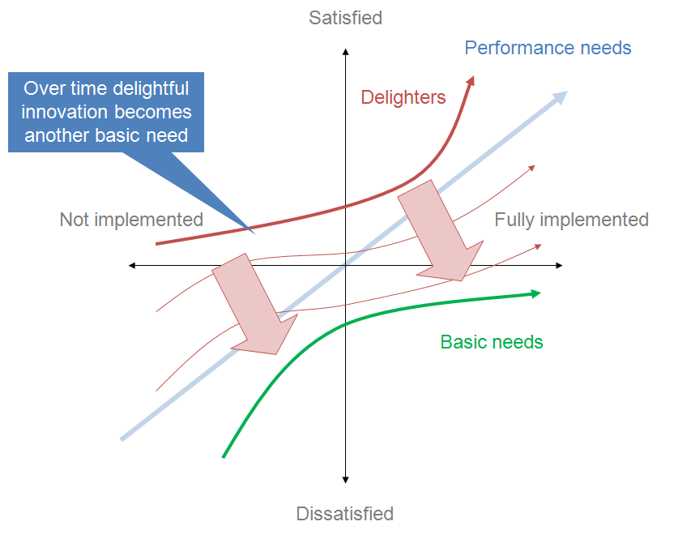
Prioritize Ideas – Kano Model

Slide 38
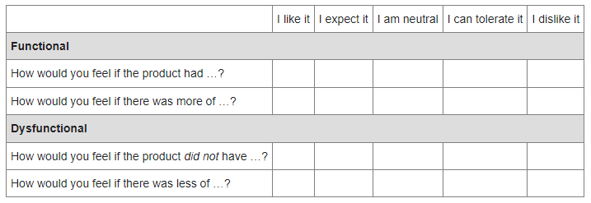
Prioritize Ideas – Kano Model
Empiric measurement
Evaluation
Kano proposes a standardized questionnaire to measure participants' opinions in an implicit way. The participants therefore need to answer two questions for each product feature, from which one is "functional" (formulated in a positive way) and one is "dysfunctional" (formulated in a negative way).
Functional |  | Dysfunctional |  | Category
I expect it | + | I dislike it | → | Must-be
I like it | + | I dislike it | → | One-dimensional
I like it | + | I am neutral | → | Attractive
I am neutral | + | I am neutral | → | Indifferent
I dislike it | + | I expect it | → | Reverse
I like it | + | I like it | → | Questionable
I dislike it | + | I dislike it | → | Questionable
Questionaire

Slide 39


Prioritize Ideas - Workshops
Prioritizing of Features and Ideas
Present Ideas
Make a workshop
Ratings from sales, product owner, customer (is the feature attractive – customer value)
Ratings from development (price tag for implementation)
High benefit/ little excitement
High benefit/
excitement
Nice
WOW
Shelf Warmer
HOT
He or she can do something better with our product
No benefit/
excitement
High excitement/
low benefit
Brings excitement to the customers. Creates attention (WOW-effect).

Slide 40
Prioritize Ideas
Buy-a-Feature-Game (find USP* features by limiting the budget)
prioritize features by limiting the budget
Decision: If somebody wants have feature a which other features can be omitted for that
Brings additional benefit in
daily clinical routine.

Slide 41
Training – Prioritize Product Features: Webshop Hotel Booking
Feature presentation

Slide 42
Agenda - From Ideas to Requirements
1
From Ideas to Requirements - A User Centered Approach
2
Usability & User Experienced Design
3
User Journey
4
Use Scenarios
5
Prototyping
6
Usability Evaluation

Slide 43
Prototyping - Wireframes
A website wireframe, also known as a page schematic or screen blueprint, is a visual guide
The wireframe depicts the page layout or arrangement of the website's content
including interface elements and
navigational systems, and
how they work together
wireframe usually lacks typographic style, color, or graphics, since the main focus lies in functionality, behavior, and priority of content
Low-fidelity (rough and quick for early stage) & High-fidelity (look-and-feel of the real product)
Wireframes focus on:
The range of functions available
The relative priorities of the information and functions
The rules for displaying certain kinds of information

Slide 44
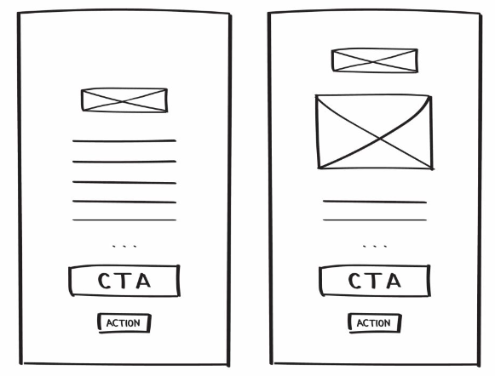
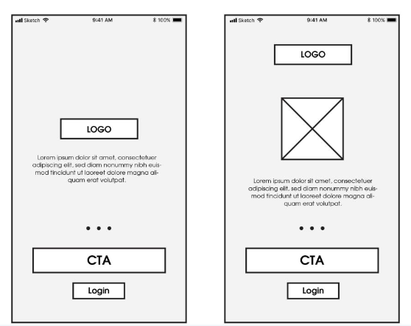
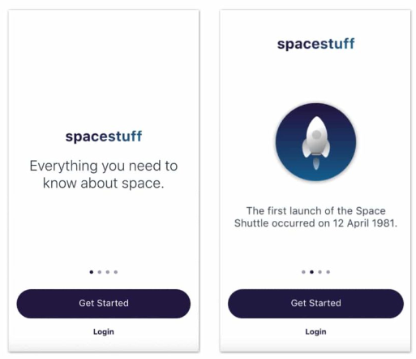
Prototyping - Wireframes
Low-fidelity wireframes
Medium-fidelity wireframes
High-fidelity wireframes

Slide 45
Prototyping
Ideation
Initial version
Update
Prototypes
Sketches -> wireframes
Functional prototypes
clickable dummies (for example clickable PDF or powerpoint)
Simple implementation
Tools for Wireframing
Balsamiq 3 Mock-up (https://balsamiq.com/)
Figma (www.figma.com)
Axure (https://www.axure.com/)
PRD
Marketing talks
Gather Existing Info (Competition Analysis, Live Cases, techncial data…)
corresponds
Hey folks, let‘s talk how to sell..
Input for talks
prototype
Input for talks
Hey user, let‘s talk about the future
Product owner
Marketing Guru
Input
Update
Usability evaluation and design iteration
Prepare first wishes, ideas and key features
Stakeholder
User
Prototype version i++
Technical feasibility
UX Design
Design concept
Hey Designer, let‘s talk about a new product
Hey Dev Guru, let‘s talk about if this is feasible
Input
Input
Product owner
UX Designer
Product owner
Dev Guru

Slide 46
Training – Wireframes: Webshop Booking Hotel
Creating wireframes with Balsamiq

Slide 47
Agenda - From Ideas to Requirements
1
From Ideas to Requirements - A User Centered Approach
2
Usability & User Experienced Design
3
User Journey
4
Use Scenarios
5
Prototyping
6
Usability Evaluation

Slide 48
Test Your Ideas
Ideation
Initial version
Update
PRD
Marketing talks
Gather Existing Info (Competition Analysis, Live Cases, techncial data…)
corresponds
Hey folks, let‘s talk how to sell..
Input for talks
prototype
Input for talks
Hey user, let‘s talk about the future
Product owner
Marketing Guru
Input
Update
Usability evaluation and design iteration
Prepare first wishes, ideas and key features
Stakeholder
User
Prototype version i++
Technical feasibility
UX Design
Design concept
Hey Designer, let‘s talk about a new product
Hey Dev Guru, let‘s talk about if this is feasible
Input
Input
Product owner
UX Designer
Product owner
Dev Guru

Slide 49
Specify the User Requirements → Create Usability Requirements
Usability Requirements do measure how well the system must do what it does. It is often measured via an interval (Questionnaire) or range (time, errors).
“The configuration software [wireless router] should be intuitive to use”
→ What means intuitive? How can I measure this?
Ambition: Make the configuration software easy to use
Scale: Average time required for a Novice to configure the wireless router for WPA.
Meter: Measurements obtained on 100 Novices during user interface
Minimum: Less than 30 seconds (Pass/Fail criteria for testing)
Target: Less than 25 seconds (If passed: Success Rating)
(Outstanding): Less than 20 seconds (If passed: Success Rating)
“The configuration of the wireless router should be performed within 20 seconds to max 30 seconds by novices without any additional help.”
Note: A novice is a user with no prior experience with any router software

Slide 50
Training – Usability Requirement: Webshop Booking Hotel
Create usability requirements

Slide 51
Components of a Usability Test
Usability lab and subjects
+
Task Scenarios
Prototype
+
???
=
Great
Usability Test

Slide 52
Define Task Scenarios as fundament for your Usability Test
Detailed task scenarios will guide you through the whole Usability test, its analysis and documentation.
First, define goals: What are the most important things that every user must be able to accomplish on the site / with the product?
Put your tasks into context: write Task Scenarios, they should be… :
Realistic: Don’t force the user to do something that he wouldn’t normally do! Asking a participant to do something that she wouldn’t normally do will make her try to complete the task without really engaging with the product / interface.
!!! Actionable: It’s best to ask the users to do the action, rather than asking them how they would do it. If you ask “How would you find a way to do X?” or “Tell me how you would do Y” the participant is likely to answer in words, not actions! People’s self-reported data is not as accurate as when they actually use a system!
Specific, without giving away the answer: Try to avoid words used in the interface; if people can sign up for the newsletter and your site has a large button labeled Sign up for newsletter, you should not phrase the task as "Sign up for this company's weekly newsletter." It's better to use a task such as: “Find a way to get information on upcoming events sent to your email on a regular basis.”

Slide 53
Training – Usability Test Task Scenario: Webshop Booking Hotel
Create a test task scenario
Derive it from use scenarios and usability requirements

Slide 54
Usability Evaluation - Setup
Prepare clickable dummy or other Prototype
Prepare protocol for documentation
Rules for Usability Evaluation
Explain the user that he or she has to conduct tasks
Aks the user to think aloud
Observe what he or she is doing
Ask questions further questions afterwards

Slide 55
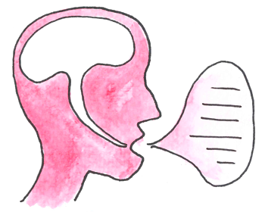
Thinking Aloud - Detect Design Difficulties
"Thinking aloud may be the single most valuable usability engineering method.“ Nielson, 1993
Instruction Example:
I pretty ask you to say out loud what you are thinking when you interact with the product. Whatever will come through your mind - your first impressions as well as when you are irritated or surprised by something - just say it out loud.
We are interested in how you are experiencing the product. Keep remember that not you are under evaluation but the product.

Slide 56
Literature & References
“Turn User Goals into Task Scenarios for Usability Testing”, https://www.nngroup.com/articles/task-scenarios-usability-testing/ ; Feb 26, 2022
ISO 9241-11 “Ergonomics of human-system interaction - Part 11: Usability: Definitions and concepts”; Edition 2018-03

Slide 57
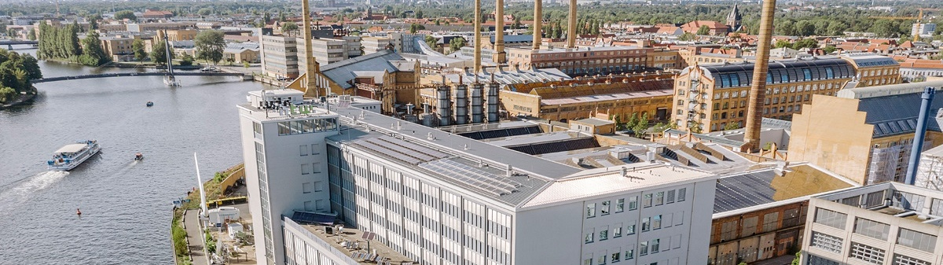
Thank you!

Slide 58
www.htw-berlin.de

